Slide 1
FINAL MSc DISSERTATION PRESENTATION
Evaluating Large Language Models for
Explaining Anomaly Detection under
Concept Drift in Cybersecurity Systems
A Cooja-based study of evolving RPL attacks, whole-seed adaptation, Sybil identity manipulation and local explanation
AL-MIZAAN JAMAL
MSc Cybersecurity | University of Sheffield
Supervisors: Dr Swagato Sanyal and Dr Prosanta Gope
CONTIKI-NG
COOJA
CONCEPT DRIFT
LOCAL QWEN
Notes:
Good morning. My name is Al-Mizaan Jamal. This dissertation asks a simple but important question: what happens when an intrusion detector learns one attack pattern and the attacker later behaves differently? I investigate that question using RPL, the routing protocol used by constrained Internet of Things networks. I built and validated attack scenarios in Contiki-NG and Cooja, converted their behaviour into a controlled dataset, tested static transfer and supervised adaptation, added a Sybil identity attack, and finally used a local language model to explain the measured evidence. The title remains focused on explanation under concept drift. The Cooja work is the controlled cybersecurity environment that makes that explanation problem measurable.
[Sources]
- /Users/mizzy/Dissertation Cooja Work/rpl-dis-flood/experiments/90 Raw Reproducibility Workspace/dissertation_overleaf_v1/chapters/01_introduction.tex
- /Users/mizzy/Downloads/dissertation_full_handover_2026-08-29.md
[/Sources]

Slide 2
THE PROBLEM
What happens when the attack changes?
TRAINING WORLD
CHANGED WORLD
STATIC IDS
RESPONSE
Blackhole-like behaviour
Packet delivery collapses
Sinkhole or Sybil
Different mechanism, different evidence
Old pattern no longer matches
Attacks may be labelled normal
Adapt using new runs
Explain the measured change
Concept drift here means the relationship between the measured features and the attack label has changed.
Controlled cross-attack distribution shift, not a claim about every form of real-world drift
Problem and motivation
Notes:
The easiest way to understand concept drift is to think about pattern matching. A detector learns from the past. In the green box, it sees Blackhole behaviour, where packets disappear after an attacker starts dropping forwarded traffic. In the red box, the malicious behaviour changes. A Sinkhole may continue forwarding but advertise an attractive rank, while a Sybil node pretends to be several identities. The old detector can then miss the attack because the evidence no longer looks like the pattern it learned. In this dissertation I create that change deliberately by training on one attack family and testing on another. This is a controlled concept-drift scenario, not proof that all real-world drift behaves the same way. The next slide explains why the LLM-focused project required this controlled experimental environment.
[Sources]
- /Users/mizzy/Dissertation Cooja Work/rpl-dis-flood/experiments/90 Raw Reproducibility Workspace/dissertation_results_summary_v1/core_argument.md
[/Sources]

Slide 3
RESEARCH LOGIC
Cooja creates the evidence needed by the LLM question
1
2
3
4
Original aim
Experimental need
Cooja contribution
Explanation layer
Explain anomaly alerts under drift
Create controlled changing cyber behaviour
Generate protocol-level RPL evidence
Turn structured results into readable analysis
The IDS detects
The pipeline produces evidence
The LLM explains
Cooja is not a side project. It is the controlled testbed for the dissertation's original explanation problem.
Problem and motivation
Notes:
The project began with the question of whether a language model could explain anomaly detection under concept drift. Before an LLM can explain anything reliably, it needs real structured evidence. That created the need for a controlled cybersecurity experiment. I therefore used Contiki-NG and Cooja to generate repeatable routing attacks, known activation times and matched controls. The IDS then converts those observations into predictions, recall, F1, feature shifts and drift alerts. Only after that does the language model receive the structured evidence and produce a readable explanation. Point to the three statements at the bottom. The detector makes the classification. The experimental pipeline produces the evidence. The LLM explains that evidence. It does not inspect Cooja by itself and it does not replace the IDS. Next I will show the paper that shaped the adaptive-detection idea.
[Sources]
- /Users/mizzy/Dissertation Cooja Work/rpl-dis-flood/experiments/90 Raw Reproducibility Workspace/dissertation_results_summary_v1/llm_layer_summary.md
- /Users/mizzy/Dissertation Cooja Work/rpl-dis-flood/experiments/90 Raw Reproducibility Workspace/llm_explanations_v2/README.md
[/Sources]

Slide 4
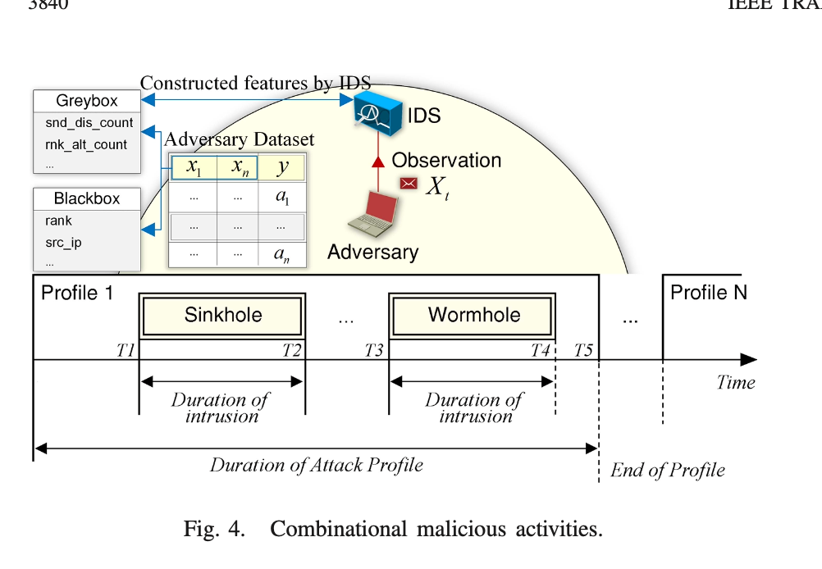
RESEARCH FOUNDATION
Gope et al. supplied the adaptive idea, not a template to copy
PAPER IDEA
MY COOJA ADAPTATION
Changing attack profiles
Nine validated RPL attack families
Adversarial observations
Logs, radio traces and routing state
Constructed feature data
810 labelled 60-second windows
Adaptive detection
Static transfer plus whole-seed adaptation
DDM and RL architecture
CUSUM/DDM plus a limited offline DQN/DDQN extension
Pasikhani, Clark and Gope (2022), Figure 4
Inspired by and adapted from the paper. Not an exact NetSim ARL reproduction.
Source: Pasikhani, Clark and Gope, Adversarial RL-Based IDS for Evolving Data Environment in 6LoWPAN, Fig. 4.
Literature and positioning
Notes:
This is the main paper that shaped the dissertation. The figure on the left shows changing malicious activities arranged as attack profiles over time. That is the idea I adapted. I did not reproduce the complete NetSim adversarial reinforcement-learning system or copy its Algorithms 1 and 2. Instead, I mapped the research question into a smaller and more auditable Cooja experiment. Multiple RPL attack families replace the paper's changing profiles. Contiki logs and routing state replace the NetSim observation stream. Whole-seed adaptation tests recovery after the attack mechanism changes. I also implemented standard DDM and DQN or DDQN principles in narrower extensions, with my own Cooja-derived states, actions, reward design and evaluation protocol. SVELTE separately motivated the importance of protocol-aware routing evidence. The honest claim is a Cooja-based extension of the underlying drift and adaptation question. Next I will explain the RPL mechanisms being changed.
[Sources]
- /Users/mizzy/Documents/Dissertation/diss papers/Adversarial_RL-Based_IDS_for_Evolving_Data_Environment_in_6LoWPAN.pdf
- /Users/mizzy/Downloads/2013-Elsevier-SVELTE realtime ID in the IoT.pdf
- /Users/mizzy/Dissertation Cooja Work/rpl-dis-flood/experiments/90 Raw Reproducibility Workspace/gope_dataset/paper_alignment.md
[/Sources]

Slide 5
RPL IN ONE MINUTE
Different RPL attacks manipulate different evidence
ROOT
Forwarding
Control plane
Blackhole, Grayhole
Delivery and response volume
DIS Flood, DIO Suppression
Control-message rate and timing
PARENT
PARENT
ATTACKER
NODE
NODE
NODE
Rank and route
DODAG = a routing graph toward the root
Path and identity
Sinkhole, Increase Rank, Worst Parent
Rank, parent choice and churn
Wormhole, Sybil
Radio path and address consistency
Technical context
Notes:
RPL is the IPv6 routing protocol used by constrained low-power networks. It organises nodes into a Destination-Oriented Directed Acyclic Graph, or DODAG, leading toward a root. The easiest way to think about rank is that it describes a node's relative position in that graph. Nodes exchange DIO control messages to advertise routing information, and DIS messages to request it. The attack families in this project change different parts of that process. Blackhole and Grayhole affect forwarding. Sinkhole and Increase Rank manipulate route attraction. DIS Flood and DIO Suppression change control traffic. Worst Parent changes parent choice. Wormhole changes the apparent path. Sybil changes identity. Point to the four callouts. This diversity is exactly why one feature representation may work for one attack and fail on another. The next slide shows how all of those mechanisms enter the experimental system.
[Sources]
- /Users/mizzy/Dissertation Cooja Work/rpl-dis-flood/experiments/90 Raw Reproducibility Workspace/dissertation_results_summary_v1/attack_coverage_table.csv
- /Users/mizzy/Dissertation Cooja Work/rpl-dis-flood/experiments/90 Raw Reproducibility Workspace/dissertation_overleaf_v1/chapters/02_literature_review.tex
[/Sources]

Slide 6
SYSTEM ARCHITECTURE
The complete system links simulation, detection and explanation
1
2
3
4
5
COOJA / CONTIKI-NG
EVIDENCE
DATASET
IDS + DRIFT
LOCAL LLM
9 attacks + controls
5 seeds per family
Logs, radio traces
RPL events
60-second features
whole-run provenance
Static transfer
adaptation, CUSUM, DDM
Structured evidence
analyst-readable explanation
COMPLETED ATTACK CAMPAIGN
Blackhole
Sinkhole
DIS Flood
Grayhole
Increase Rank
DIO Suppression
Worst Parent
Wormhole
Sybil
The IDS detects. The drift pipeline measures change. The LLM explains the supplied evidence.
Methodology
Notes:
This is the map of the whole dissertation. On the left, Cooja executes the Contiki-NG applications and modified RPL behaviour. Each completed attack has a matched control and five seeds. The simulator produces logs, radio traces and routing events. Those are converted into sixty-second windows while preserving which complete run and seed each row came from. The middle stage tests static cross-attack transfer, whole-seed adaptation and online change detection. The final stage packages the measured evidence for a local Qwen model running through Ollama. The nine labels at the bottom are the completed campaign, not a proposed list. The key separation is shown in the final sentence. Detection, drift monitoring and explanation are distinct tasks. The next slide explains the timing and leakage control that make the evaluation defensible.
[Sources]
- /Users/mizzy/Dissertation Cooja Work/rpl-dis-flood/experiments/90 Raw Reproducibility Workspace/dissertation_results_summary_v1/results_summary.md
- /Users/mizzy/Dissertation Cooja Work/rpl-dis-flood/experiments/90 Raw Reproducibility Workspace/final_simulated_dataset_v1/evaluation_protocol.md
[/Sources]

Slide 7
EXPERIMENTAL PROTOCOL
Attack timing and whole-seed separation prevent optimistic results
0 s
240 s
540 s
Normal warm-up and routing formation
Attack active
0-60
60-120
120-180
180-240
240-300
300-360
360-420
420-480
480-540
60-second feature windows
WRONG SPLIT
CORRECT SPLIT
Seed 123456 windows
TRAIN
TEST
Seed 123456
TRAIN
Complete simulations stay together
Parts of the same run appear on both sides
Seed 345678
TEST
16 nodes | 5 attack seeds + 5 controls per family | 540 seconds | attack begins at 240 seconds
Methodology
Notes:
Every baseline scenario runs for five hundred and forty simulated seconds. The attack begins at two hundred and forty seconds, after the network has had time to form routes. I then extract sixty-second feature windows. The important methodological point is the split shown at the bottom. Each simulation produces several related rows. A random row split could place some windows from seed 123456 in training and other windows from the same run in testing. That would let the model benefit from run-specific behaviour and make the score optimistic. I therefore keep each complete seed on one side of the split. During adaptation, the model receives one or more complete target-attack seeds and is evaluated on different unseen seeds. Point to the green correct split. That whole-seed rule is central to the credibility of the results shown later. Before training any model, however, I first verified that the attacks themselves were executing.
[Sources]
- /Users/mizzy/Dissertation Cooja Work/rpl-dis-flood/experiments/90 Raw Reproducibility Workspace/final_simulated_dataset_v1/evaluation_protocol.md
- /Users/mizzy/Dissertation Cooja Work/rpl-dis-flood/experiments/90 Raw Reproducibility Workspace/dissertation_results_summary_v1/attack_coverage_table.csv
[/Sources]

Slide 8
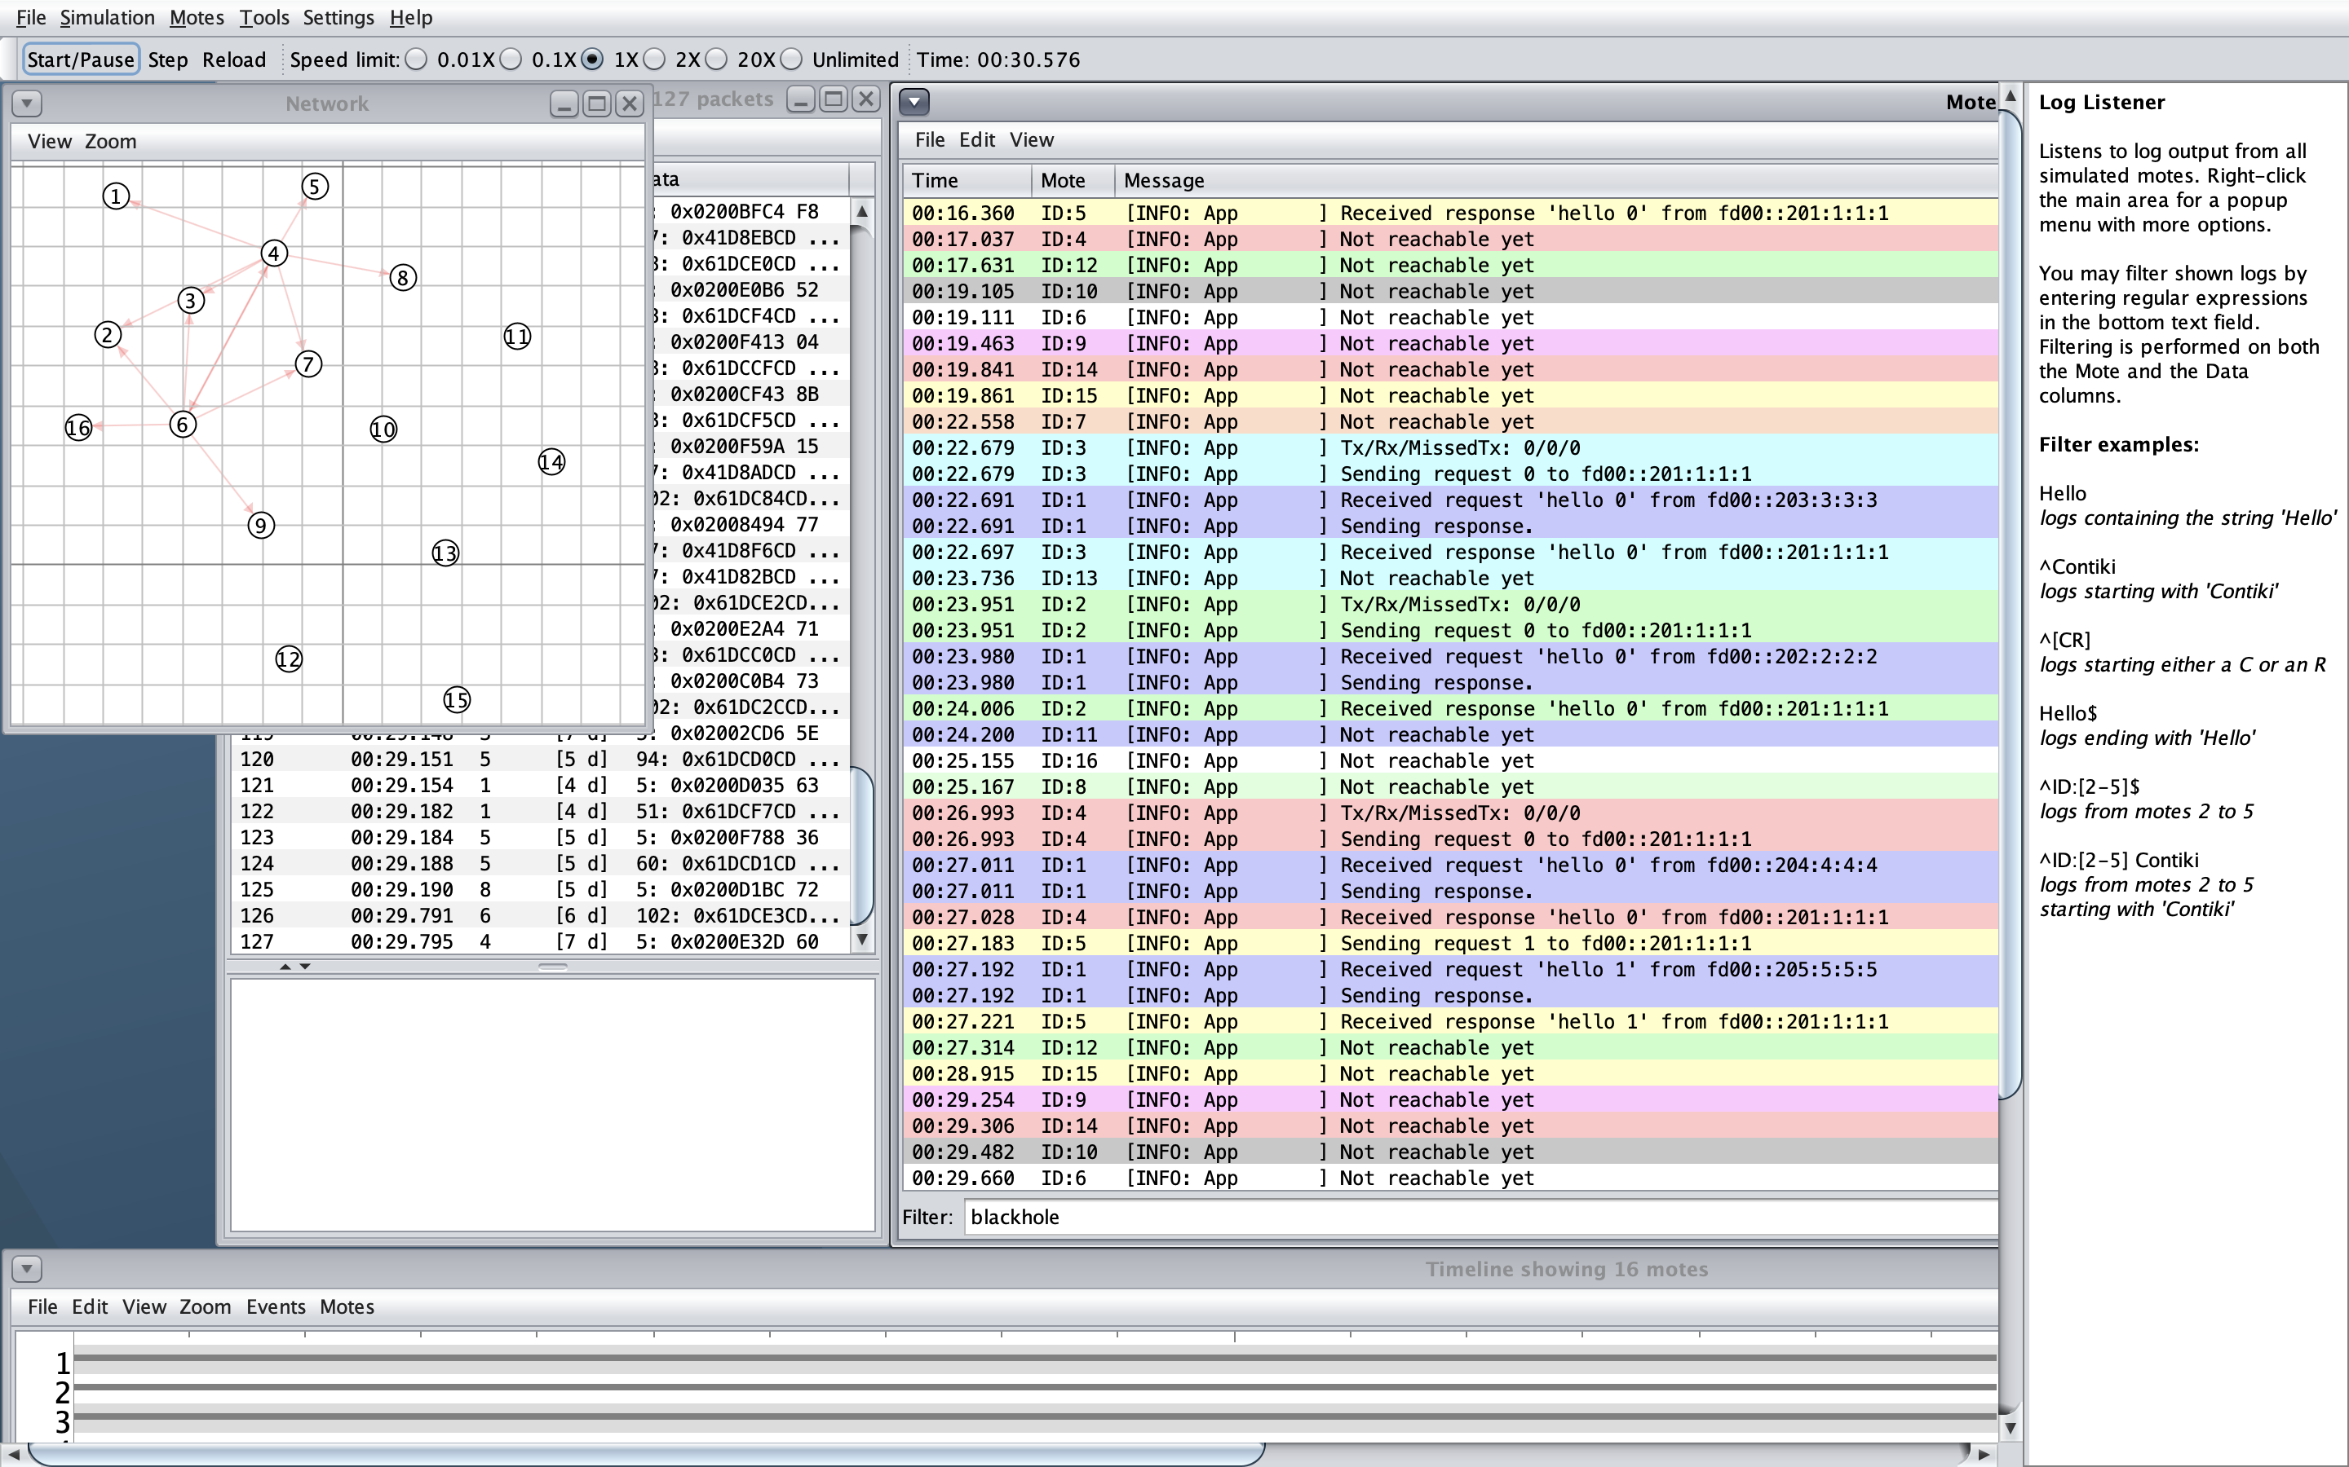
ATTACK VALIDATION
The dataset labels are grounded in real Cooja behaviour
BLACKHOLE
04:00.473 BLACKHOLE ATTACK: enabled
04:01.055 dropping forwarded packet
SINKHOLE
04:00.473 SINKHOLE ATTACK: enabled
04:00.473 advertising rank 128 instead of 256
SYBIL
04:00.703 SYBIL ATTACK: enabled
04:02.703 sending DIO as identity fd00::f001
16-mote Cooja topology and live log view
90 validated baseline runs: 45 attack + 45 matched control
Evidence shown from preserved COOJA.testlog files; attack markers were excluded from model predictors.
Implementation evidence
Notes:
Before making any machine-learning claim, I checked that each attack activated and produced the intended protocol-level effect. The left side shows the real Cooja environment with sixteen motes and the log listener. On the right are preserved lines from completed runs. The Blackhole hook begins dropping forwarded packets after four minutes. The Sinkhole advertises rank 128 while preserving its internal rank of 256. The Sybil node rotates the source identity used for outgoing DIO messages, here showing fd00::f001. These markers validate the implementation and establish ground truth, but they are not included as predictive features. Across nine families there are forty-five attack and forty-five matched control runs. This step matters because a labelled dataset is only meaningful if the label corresponds to behaviour that actually occurred. The next slide shows how these raw events become the IDS dataset.
[Sources]
- /Users/mizzy/Dissertation Cooja Work/rpl-dis-flood/experiments/90 Raw Reproducibility Workspace/blackhole/final_corrected_240s_540s/runs/BH_ATTACK_N16_SEED123456/COOJA.testlog
- /Users/mizzy/Dissertation Cooja Work/rpl-dis-flood/experiments/90 Raw Reproducibility Workspace/sinkhole/final_corrected_240s_540s/runs/SH_ATTACK_N16_SEED123456/COOJA.testlog
- /Users/mizzy/Dissertation Cooja Work/rpl-dis-flood/experiments/90 Raw Reproducibility Workspace/sybil_attack_v1/runs/SYBIL_ATTACK_N16_SEED567890/COOJA.testlog
- /Users/mizzy/Dissertation Cooja Work/rpl-dis-flood/experiments/90 Raw Reproducibility Workspace/dissertation_results_summary_v1/attack_coverage_table.csv
[/Sources]

Slide 9
FEATURE CONSTRUCTION
Raw protocol events become an auditable IDS dataset
RAW EVENTS
60-SECOND WINDOW
FEATURE VECTOR
LABEL
GROUP
packet receptions
DIO / DIS / DAO
rank and parent state
counts, minima, deltas
unique senders
parent switches
traffic | routing | rank
control | identity
normal before 240 s
attack after activation
family + seed + mode
kept outside predictors
810
90
84
57
16
windows
run groups
columns
generic predictors
excluded markers / provenance
Simulator attack markers, labels and run identifiers are retained for audit but excluded from prediction.
Methodology
Notes:
This slide follows one sixty-second observation from raw evidence to model input. Cooja produces packet and routing events. The extractor groups those events into fixed windows and computes traffic, control-message, rank, parent and identity measurements. A label describes whether that window belongs to normal operation or the post-activation attack period. The family, seed, mode and attack markers remain in the dataset for provenance and validation, but they are not predictors. The frozen dataset contains eight hundred and ten windows from ninety complete run groups. It has eighty-four columns, of which fifty-seven are generic predictive features. Sixteen attack-marker or provenance fields are explicitly excluded from the model. This design makes it possible to audit exactly where a row came from without allowing the classifier to read the answer. With that foundation in place, the next slide presents the central static-transfer result.
[Sources]
- /Users/mizzy/Dissertation Cooja Work/rpl-dis-flood/experiments/90 Raw Reproducibility Workspace/final_simulated_dataset_v1/data_dictionary.md
- /Users/mizzy/Dissertation Cooja Work/rpl-dis-flood/experiments/90 Raw Reproducibility Workspace/final_simulated_dataset_v1/evaluation_protocol.md
- /Users/mizzy/Dissertation Cooja Work/rpl-dis-flood/experiments/90 Raw Reproducibility Workspace/final_simulated_dataset_v1/audit/dataset_quality_audit.md
[/Sources]

Slide 10
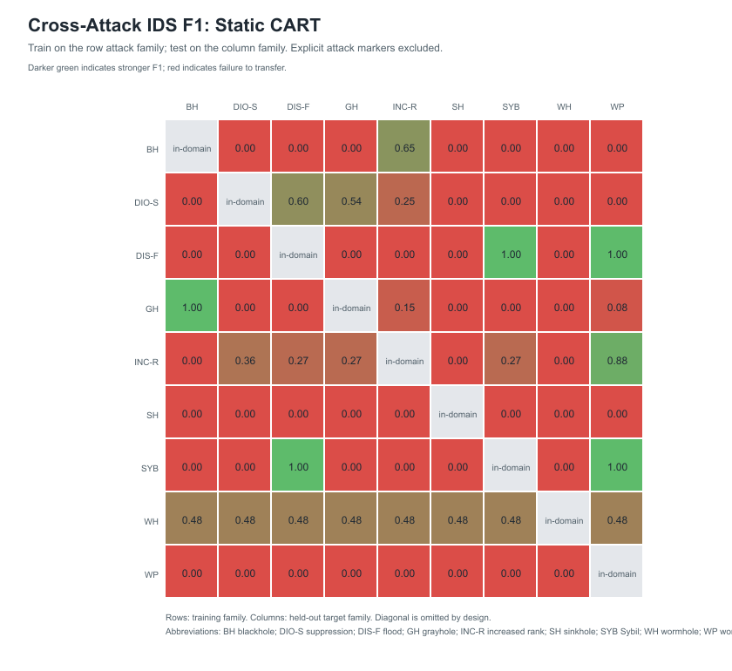
MAIN RESULT
Static cross-attack detection fails often
48 / 72
cross-attack pairs with zero attack recall
6 / 72
pairs with F1 at least 0.80
0.182
mean cross-attack F1
Rows = training family | columns = different test family
Concept drift result
Notes:
This heatmap is the central concept-drift result. Each row is the attack family used for training, and each column is a different family used for testing. The colour represents held-out F1, which balances precision and recall. Recall tells us how many attack windows were actually detected. Forty-eight of the seventy-two off-diagonal CART combinations have zero attack recall, meaning the detector missed every attack window in those changed environments. Only six pairs reach F1 of at least zero point eight. The mean cross-attack F1 is zero point one eight two. Accuracy alone would hide part of this failure because control and pre-attack windows are labelled normal. The correct conclusion is that static cross-attack transfer is brittle under this controlled distribution shift. It is not a claim that CART can never work, and it is not proof about every form of field drift. The next slide explains why feature representation changed one of the most important conclusions.
[Sources]
- /Users/mizzy/Dissertation Cooja Work/rpl-dis-flood/experiments/90 Raw Reproducibility Workspace/dissertation_final_figures_v2/tables/cross_attack_cart_f1.csv
- /Users/mizzy/Dissertation Cooja Work/rpl-dis-flood/experiments/90 Raw Reproducibility Workspace/dissertation_results_summary_v1/concept_drift_key_metrics.csv
[/Sources]

Slide 11
FAILURE ANALYSIS
Retraining cannot learn a mechanism the features do not expose
EARLY REPRESENTATION
MECHANISM-AWARE REPRESENTATION
Coarse traffic evidence
Rank + parent + routing state
delivery, radio volume, responses
persistent low-rank advertisements become visible
Static F1
0.000
1-seed F1
0.813
3-seed F1
0.098
3-seed F1
0.973
Adding Sinkhole examples still leaves the rank mechanism mostly invisible.
Held-out recall reaches 0.95 with false-positive rate 0.
Research correction
The early failure was not hidden. The feature space was revised before making a broader adaptation claim.
Blackhole -> Sinkhole, 60-second windows, whole-seed evaluation
Feature representation
Notes:
This slide shows the most important methodological correction in the project. The early Blackhole-to-Sinkhole experiment used coarse traffic and radio features. Static F1 was zero, and even after three Sinkhole seeds the F1 was only zero point zero nine eight. The reason is mechanical: Blackhole changes forwarding, while Sinkhole changes advertised rank and route attraction. Retraining cannot recover information that the feature set never records. I therefore added persistent low-rank, parent and routing-state evidence. With those features, one complete Sinkhole seed raises held-out F1 to zero point eight one three, and three seeds raise it to zero point nine seven three with recall zero point nine five and no false positives in this campaign. Point from the red side to the green side. The lesson is not that retraining always works. Adaptation works when the representation exposes the new mechanism. The next slide asks how much target data is needed across all nine families.
[Sources]
- /Users/mizzy/Dissertation Cooja Work/rpl-dis-flood/experiments/90 Raw Reproducibility Workspace/results/master_results_summary.csv
- /Users/mizzy/Dissertation Cooja Work/rpl-dis-flood/experiments/90 Raw Reproducibility Workspace/routing_features_v1/results/RESULTS_INTERPRETATION.md
[/Sources]

Slide 12
WHOLE-SEED ADAPTATION
One complete target seed gives the largest average recovery
Mean held-out F1
What the curve means
1.0
0.879
0.826
0.866
0 seeds
Static cross-attack transfer is weak
1 seed
Largest average recovery
2-3 seeds
Smaller additional gains
0.75
0.50
0.25
0.182
Every test seed remains a different, complete simulation.
0.0
0 seeds
1 seed
2 seeds
3 seeds
Adaptation result
Notes:
Whole-seed adaptation asks how much labelled evidence from the changed environment is required. At zero target seeds, the model only knows the source attack and mean F1 is zero point one eight two two. Adding one complete target seed produces the largest recovery, increasing mean F1 to zero point eight two five eight. Two seeds reach zero point eight six six four, and three reach zero point eight seven nine two. The evaluation always uses different complete target seeds, so this is not training and testing on windows from the same simulation. The curve supports rapid average recovery, but it does not mean every source-target pair improves monotonically. Some pairs remain unstable or fail completely, especially when the features still do not distinguish the changed mechanism. I would therefore describe this as strong average supervised recovery with important pair-specific limitations. The next slide focuses on Sybil, the identity-based extension that creates a deliberately different attack surface.
[Sources]
- /Users/mizzy/Dissertation Cooja Work/rpl-dis-flood/experiments/90 Raw Reproducibility Workspace/dissertation_results_summary_v1/adaptation_key_metrics.csv
- /Users/mizzy/Dissertation Cooja Work/rpl-dis-flood/experiments/90 Raw Reproducibility Workspace/cross_attack_adaptation_with_sybil_v1/cross_attack_adaptation_summary.csv
[/Sources]

Slide 13
ORIGINAL EXTENSION
Sybil changes the attack surface from behaviour to identity
BEFORE ACTIVATION
AFTER 240 SECONDS
fd00::f001
NODE 16
NODE 16
fd00::f002
one identity
fd00::f003
fd00::f004
Why it is different
0.218
0.968
50 / 50
- forwarding may remain normal
- rank alone may remain plausible
- identity consistency becomes the key evidence
static target F1
F1 after 1 seed
attack windows alerted
Identity monitor controls: 0 / 45 alerts
Contribution: controlled Cooja implementation and drift evaluation, not invention of the Sybil attack.
Sybil contribution
Notes:
A Sybil attack means one real node pretends to be several different identities. Before activation, node sixteen uses one normal source identity. After activation, it rotates virtual IPv6 identities in outgoing RPL DIO messages. This attack was selected because it changes the evidence surface. A forwarding or rank detector can appear healthy while identity consistency has changed. Static models trained on other families transfer poorly to Sybil, with mean target F1 zero point two one eight. After one complete Sybil adaptation seed, held-out F1 rises to zero point nine six eight. I also implemented a transparent identity monitor. It alerts on all fifty post-activation attack windows and on none of the forty-five control windows in this controlled address plan. That monitor is not a universal deployed Sybil defence. It is a mechanism-specific observable that demonstrates why identity evidence matters. The contribution is the implementation and evaluation within this Cooja drift framework, not the invention of Sybil attacks. The next slide separates online change detection from adaptation.
[Sources]
- /Users/mizzy/Dissertation Cooja Work/rpl-dis-flood/experiments/90 Raw Reproducibility Workspace/dissertation_results_summary_v1/sybil_contribution_summary.md
- /Users/mizzy/Dissertation Cooja Work/rpl-dis-flood/experiments/90 Raw Reproducibility Workspace/adversarial_rl_sybil_v1/results/sybil_identity_monitor_summary.csv
- /Users/mizzy/Dissertation Cooja Work/rpl-dis-flood/experiments/90 Raw Reproducibility Workspace/dissertation_results_summary_v1/adaptation_key_metrics.csv
[/Sources]

Slide 14
ONLINE RESPONSE
Detecting change is separate from retraining the classifier
Sinkhole attack activates
First post-activation window
One window later
240 s
CUSUM
DDM
Routing-state evidence changes
Delayed classifier errors arrive
0 s
5 / 5 attacks detected
0 / 5 controls alerted
60 s
5 / 5 attacks detected
0 / 5 controls alerted
median window delay
median delay
Mechanism-aware telemetry triggered before labelled classifier errors were available.
Drift monitoring
Notes:
CUSUM and DDM answer a different question from adaptation: when should the system suspect that something has changed? CUSUM, or cumulative sum control, watches a measurement over time and alerts when the change becomes consistently too large to look normal. Here it watches the low-rank routing-state signal. DDM, or Drift Detection Method, watches the classifier's mistakes, so it depends on delayed labels and reacts later. Across five Sinkhole attacks and five controls, both detectors alert on all attacks and no controls. CUSUM alerts in the first post-activation window, while DDM alerts one sixty-second window later. The sample is small and controlled, so the zero control-alert rate is not a field false-alarm estimate. The result shows that mechanism-aware telemetry can provide an earlier trigger than waiting for the classifier's labelled error rate to deteriorate. Next I test whether the main adaptation result survives changed radio conditions and compare its direction with the supplied external data.
[Sources]
- /Users/mizzy/Dissertation Cooja Work/rpl-dis-flood/experiments/90 Raw Reproducibility Workspace/dissertation_final_figures_v2/tables/online_drift_detection_summary.csv
- /Users/mizzy/Dissertation Cooja Work/rpl-dis-flood/experiments/90 Raw Reproducibility Workspace/routing_features_v1/results/drift_detector_summary.csv
[/Sources]

Slide 15
ROBUSTNESS AND EXTERNAL EVIDENCE
The recovery pattern survives simulator changes, with clear limits
THREE-SEED ADAPTED F1
60 additional Cooja runs
Relocated Blackhole
1.000
External direction check
Relocated Sinkhole
1.000
0.995
0.088
Relocated Sybil
Gope-data F1
Lossy Blackhole
1.000
Blackhole -> Sinkhole
recall 0.047
Lossy Sinkhole
1.000
Lossy Sybil
0.937
Different simulator, schema and split. Direction only.
Lossy Sybil is the weakest adapted condition: F1 0.937, FPR 0.046.
Robustness
Notes:
The robustness campaign adds sixty simulations with attacker relocation and a lossy radio model. After three target seeds, adapted F1 remains near one across Blackhole, Sinkhole and Sybil. The weakest condition is lossy-radio Sybil at F1 zero point nine three seven, with false-positive rate zero point zero four six. This supports robustness within the evaluated simulator conditions, not physical deployment generalisation. I also analysed the supplied Gope dataset separately. A Gaussian model trained on Blackhole and tested on Sinkhole achieves recall zero point zero four seven and F1 zero point zero eight eight, showing the same direction of weak cross-attack transfer. Those values must not be ranked directly against Cooja because the simulator, schema, labels and split units differ. Together, the results support the transfer problem while keeping the validity boundary explicit. The next slide reports three more complex extensions, including negative results.
[Sources]
- /Users/mizzy/Dissertation Cooja Work/rpl-dis-flood/experiments/90 Raw Reproducibility Workspace/dissertation_final_figures_v2/tables/robustness_static_vs_adapted.csv
- /Users/mizzy/Dissertation Cooja Work/rpl-dis-flood/experiments/90 Raw Reproducibility Workspace/results/master_results_summary.csv
- /Users/mizzy/Dissertation Cooja Work/rpl-dis-flood/experiments/90 Raw Reproducibility Workspace/gope_dataset/paper_alignment.md
[/Sources]

Slide 16
OPERATIONAL EXTENSIONS
More sophistication did not automatically improve the system
TRUST FEATURES
ACTIVE DEFENCE
DQN / DDQN
NO DETECTION GAIN
Static F1
0.182 -> 0.182
Three-seed F1
0.879 -> 0.879
Useful as diagnostic evidence, not as an accuracy claim.
DESTABILISED ROUTING
Application responses
417 -> 87
Radio transmissions
5,217 -> 35,020
Detection did not make intervention safe.
DID NOT BEAT THE BASELINE
Always incremental F1
0.667
Best RL controller F1
0.571
Complexity did not justify itself.
Extra complexity is useful only when it improves the correct objective without unacceptable network cost.
Trust, defence and RL
Notes:
These extensions produced important negative results. First, the trust layer turned routing observations into interpretable forwarding, rank, control and route signals, but it did not change CART F1. It is therefore presented as diagnostic evidence, not a performance improvement. Second, the active Sinkhole defence rejected suspicious routes too aggressively. Application responses fell by about seventy-nine percent, radio transmissions increased by over five hundred percent, and the network switched parent hundreds of times. Detection confidence alone is not enough for safe routing intervention. Third, the isolated DQN and DDQN controllers selected update actions on recorded Cooja-derived streams. DDQN improved over DQN, but neither beat the simple always-incremental baseline. This is not the full live adversarial system from Gope et al. These results strengthen the dissertation because they show where intuitive extensions fail and why operational cost matters. The next slide returns to the local language-model explanation layer.
[Sources]
- /Users/mizzy/Dissertation Cooja Work/rpl-dis-flood/experiments/90 Raw Reproducibility Workspace/trust_layer_v1/results/trust_vs_baseline_comparison.csv
- /Users/mizzy/Dissertation Cooja Work/rpl-dis-flood/experiments/90 Raw Reproducibility Workspace/dissertation_final_figures_v2/tables/sinkhole_defence_operational_cost.csv
- /Users/mizzy/Dissertation Cooja Work/rpl-dis-flood/experiments/90 Raw Reproducibility Workspace/adversarial_rl_sybil_v1/results/adversarial_rl/held_out_summary.csv
- /Users/mizzy/Dissertation Cooja Work/rpl-dis-flood/experiments/90 Raw Reproducibility Workspace/adversarial_rl_sybil_v1/docs/model_scope.md
[/Sources]

Slide 17
EXPLANATION LAYER
The local LLM explains evidence produced by the IDS pipeline
STRUCTURED EVIDENCE
ACTUAL ABRIDGED OUTPUT
Window: 300-360 s
Low-rank DIO count: +14
Minimum non-root rank: -128
Rank trust alert: 1
Static transfer: weak
Adaptation: improved
Drift alert: present
"There has been a significant increase in low-rank DIO observations and a decrease in the minimum non-root rank.
These changes suggest a possible drift and should be investigated further."
QWEN
2.5:3B
Local Ollama runtime
No cloud key required
Confidence: medium | limitation stated
THE IDS DETECTS. THE LLM EXPLAINS.
Real Sinkhole evidence shown | full nine-case evaluation follows
Local LLM
Notes:
The local explanation layer runs Qwen two point five, three billion parameters, through Ollama on the same computer. It does not receive thousands of raw Cooja lines. It receives a structured evidence package containing feature changes, IDS results, drift alerts, adaptation outcomes and limitations. The example here is based on the real Sinkhole case. The model identifies the increase in low-rank observations and the lower non-root rank, describes possible drift, assigns medium confidence and asks for further investigation. The distinction at the bottom is central to the dissertation: the IDS makes the detection decision, while the language model explains evidence that already exists. It cannot inspect Cooja independently and it is not allowed to invent measurements. The next slide evaluates the nine generated explanations and states exactly what that evaluation does and does not prove.
[Sources]
- /Users/mizzy/Dissertation Cooja Work/rpl-dis-flood/experiments/90 Raw Reproducibility Workspace/llm_explanations_v2/outputs/ollama_explanations.jsonl
- /Users/mizzy/Dissertation Cooja Work/rpl-dis-flood/experiments/90 Raw Reproducibility Workspace/llm_explanations_v2/evaluation/scored_ollama_full/summary.json
- /Users/mizzy/Dissertation Cooja Work/rpl-dis-flood/experiments/90 Raw Reproducibility Workspace/llm_explanations_v2/evaluation/scored_ollama_full/case_scores.csv
[/Sources]

Slide 18
LLM EVALUATION
The nine explanations pass structural checks, not human evaluation
9
100%
7.78 / 10
0%
attack-family cases
schema-valid outputs
mean evidence-alignment score
unsupported-claim flags
What this supports
What this does not prove
- the local model followed the required JSON structure
- explanations referred to supplied evidence
- limitations and uncertainty were usually present
- all nine attack cases were processed locally
- analysts found the explanations useful
- every protocol term was technically precise
- the score is equivalent to human judgement
- the model would remain reliable on unseen deployments
The result is evidence-grounded automatic screening, not a human analyst study.
Local LLM
Notes:
This slide is the actual evaluation of the local explanation layer. I generated one explanation for each of the nine attack-family cases. All nine outputs conformed to the required schema. The project's automatic rubric gave a mean evidence-alignment score of seven point seven eight out of ten, and its unsupported-claim rules raised no flags. These results support a limited claim: the local model can convert the supplied IDS and drift evidence into a consistently structured explanation without obvious unsupported additions under this rule set. They do not demonstrate analyst usefulness, complete factual correctness or deployment reliability. The screening is deterministic and transparent, but it cannot recognise every subtle protocol error. A blinded human evaluation with security analysts would therefore be the correct next step. If I perform the live demonstration after this slide, I will briefly show a validated Cooja attack marker, then run one local Qwen explanation in Visual Studio Code. I will keep the demonstration under five minutes and use the preserved recordings and nine-case output if either application is slow.
[Sources]
- /Users/mizzy/Dissertation Cooja Work/rpl-dis-flood/experiments/90 Raw Reproducibility Workspace/presentation_demo_pack_v1/recording_checklist.md
- /Users/mizzy/Dissertation Cooja Work/rpl-dis-flood/experiments/90 Raw Reproducibility Workspace/presentation_demo_pack_v1/terminal_commands.md
- /Users/mizzy/Dissertation Cooja Work/rpl-dis-flood/experiments/90 Raw Reproducibility Workspace/llm_explanations_v2/outputs/ollama_explanations.jsonl
- /Users/mizzy/Dissertation Cooja Work/rpl-dis-flood/experiments/90 Raw Reproducibility Workspace/llm_explanations_v2/evaluation/scored_ollama_full/summary.json
- /Users/mizzy/Dissertation Cooja Work/rpl-dis-flood/experiments/90 Raw Reproducibility Workspace/llm_explanations_v2/evaluation/scored_ollama_full/case_scores.csv
[/Sources]

Slide 19
CRITICAL REFLECTION
Failures changed the method and narrowed the claims
PROBLEM OBSERVED
CORRECTION MADE
RESEARCH LESSON
Coarse features missed Sinkhole
Added rank, parent and routing-state evidence
Features must expose the mechanism
Random-row leakage risk
Separated complete seeds and runs
The split unit matters as much as the model
Active defence destabilised routing
Measured response, radio and churn cost
Detection does not guarantee safe mitigation
The contribution includes correcting failed assumptions, not only reporting the best score.
Discussion
Notes:
This slide summarises how the research improved through failure analysis. The first Sinkhole adaptation attempt failed because the representation was too coarse, so I added routing-state evidence. I identified that random window splitting could leak related rows, so all evaluations preserve complete seeds. Trust features did not improve predictive F1, so I narrowed the claim to diagnostic interpretation. The active defence caused major network disruption, so I report it as a failed prototype and derive requirements for hysteresis, confidence and route stability. The DQN and DDQN controllers did not beat always-incremental updating, so I keep the simpler baseline as the stronger result. These are not side notes. They show that the project changed its method and its claims in response to evidence. That critical correction process is part of the dissertation contribution. The final slide now states only what the completed evidence supports.
[Sources]
- /Users/mizzy/Dissertation Cooja Work/rpl-dis-flood/experiments/90 Raw Reproducibility Workspace/dissertation_overleaf_v1/chapters/06_discussion.tex
- /Users/mizzy/Dissertation Cooja Work/rpl-dis-flood/experiments/90 Raw Reproducibility Workspace/dissertation_overleaf_v1/chapters/07_limitations.tex
[/Sources]

Slide 20
CONCLUSIONS
What the evidence supports
1
Static transfer is brittle
48 of 72 cross-attack CART pairs miss every attack window.
2
Features determine adaptability
Routing-state evidence changes the Blackhole-to-Sinkhole result.
3
Limited adaptation often recovers performance
Mean F1 rises from 0.182 to 0.826 after one complete target seed.
4
Sybil adds an identity-based surface
Static transfer is weak; one held-out adaptation seed reaches F1 0.968.
5
Explanation must remain evidence-grounded
The local LLM describes measured results but does not replace detection.
Changing attacks require adaptive detection and understandable evidence.
Questions
AL-MIZAAN JAMAL
Notes:
The evidence supports five conclusions. First, static cross-attack transfer is brittle: forty-eight of seventy-two CART pairs miss every attack window. Second, feature representation determines whether adaptation is even possible. Third, adding one complete target seed gives the largest average recovery, although some pairs remain unstable. Fourth, Sybil provides a distinct identity-based surface and becomes strongly detectable after limited supervised adaptation or through a transparent identity-specific monitor. Fifth, the local language model can turn structured evidence into a readable explanation, but it is not the detector and its automatic score is not a human usefulness study. The project is simulation-based and does not claim physical deployment performance or a full reproduction of Gope et al.'s adversarial RL architecture. The central conclusion is shown at the bottom: changing attacks require both adaptive detection and understandable evidence. Thank you. I welcome your questions.
[Sources]
- /Users/mizzy/Dissertation Cooja Work/rpl-dis-flood/experiments/90 Raw Reproducibility Workspace/dissertation_results_summary_v1/results_summary.md
- /Users/mizzy/Dissertation Cooja Work/rpl-dis-flood/experiments/90 Raw Reproducibility Workspace/dissertation_results_summary_v1/core_argument.md
[/Sources]

Slide 21
SUPPORTING ANALYSIS
Full attack-family campaign
FAMILY
SURFACE
VALIDATED MECHANISM
ATTACK + CONTROL
Blackhole
Forwarding
Drop forwarded packets
5 + 5
Sinkhole
Rank
Advertise rank 128 instead of 256
5 + 5
DIS Flood
Control
Repeated DIS transmission
5 + 5
Grayhole
Forwarding
Selective packet drop
5 + 5
Increase Rank
Rank
Advertise degraded rank
5 + 5
DIO Suppression
Control
Suppress DIO transmission
5 + 5
Worst Parent
Route
Choose poor parent
5 + 5
Wormhole
Path
Directed radio tunnel
5 + 5
Sybil
Identity
Rotate DIO source identity
5 + 5
Baseline campaign total: 90 validated simulations
Supplementary results
Notes:
This table summarises the complete baseline simulation campaign. The nine families deliberately cover different RPL evidence surfaces: forwarding, rank, control traffic, route choice, path manipulation and identity. Every family has five attack runs and five matched controls, giving ninety validated simulations in total. The same seed set is used on both sides of each attack-control comparison. The important point is that the dataset is not nine names attached to one generic anomaly. Each implementation changes a specific protocol mechanism, and each mechanism was checked using preserved Cooja markers and behavioural evidence. Sybil is highlighted because it extends the campaign from routing behaviour into identity consistency. The table supports coverage and reproducibility, but it does not imply that all possible RPL attacks or deployment conditions were tested.
[Sources]
- /Users/mizzy/Dissertation Cooja Work/rpl-dis-flood/experiments/90 Raw Reproducibility Workspace/dissertation_results_summary_v1/attack_coverage_table.csv
[/Sources]

Slide 22
SUPPORTING ANALYSIS
Static transfer fails across two model families
CART
GAUSSIAN
48 / 72
6 / 72
66 / 72
0 / 72
zero-recall pairs
F1 at least 0.8
zero-recall pairs
F1 at least 0.8
0.1822
0.0362
mean F1
mean F1
Both models support the same direction of failure; CART is stronger but still brittle.
Supplementary results
Notes:
This comparison checks whether the static-transfer conclusion is an artefact of choosing CART. CART is the stronger of the two models, but forty-eight of seventy-two cross-attack pairs still have zero attack recall and mean F1 is only zero point one eight two two. The Gaussian model performs even worse, with sixty-six zero-recall pairs and mean F1 zero point zero three six two. Because both models fail in the same direction, the central result is not limited to one classifier. However, this is not an exhaustive model benchmark. The purpose is to test the stability of the cross-attack conclusion with a transparent tree model and a different distributional baseline, not to claim that every possible IDS would fail identically.
[Sources]
- /Users/mizzy/Dissertation Cooja Work/rpl-dis-flood/experiments/90 Raw Reproducibility Workspace/dissertation_results_summary_v1/concept_drift_key_metrics.csv
[/Sources]

Slide 23
SUPPORTING ANALYSIS
Adaptation outcomes depend on the source-target pair
Source -> target
Static
1 seed
2 seeds
3 seeds
Pattern
Blackhole -> DIS Flood
0.000
1.000
1.000
1.000
Immediate recovery
Blackhole -> Sinkhole
0.000
0.571
0.966
0.947
Two seeds best
Blackhole -> Wormhole
0.000
0.778
0.692
0.727
Non-monotonic
DIO Suppression -> Sybil
0.000
0.889
0.846
0.750
Degrades with more data
DIS Flood -> DIO Suppression
0.000
0.000
0.000
0.000
Persistent failure
Grayhole -> Blackhole
1.000
1.000
1.000
1.000
Mechanism transfer
Supplementary results
Notes:
The main adaptation curve reports an average, so this table shows why that average must be qualified. Some pairs recover immediately, such as Blackhole to DIS Flood. Others improve only after two seeds, such as Blackhole to Sinkhole. Blackhole to Wormhole is non-monotonic, and DIO Suppression to Sybil becomes weaker as more target seeds are added. DIS Flood to DIO Suppression remains at F1 zero throughout, while Grayhole to Blackhole transfers perfectly because their forwarding-loss mechanisms are similar. The scientific conclusion is therefore not that more target data guarantees monotonic improvement. Adaptation depends on mechanism overlap, feature visibility and the small set of available whole runs. The aggregate recovery is strong, but pair-specific behaviour remains heterogeneous.
[Sources]
- /Users/mizzy/Dissertation Cooja Work/rpl-dis-flood/experiments/90 Raw Reproducibility Workspace/cross_attack_adaptation_with_sybil_v1/cross_attack_adaptation_summary.csv
[/Sources]

Slide 24
SUPPORTING ANALYSIS
Sybil intensity changes identity evidence more than traffic volume
RATE CAMPAIGN
Control spoof markers
0
Identity monitor
Low-rate spoof markers
29
50 / 50
0 / 45
High-rate spoof markers
299
post-activation attack windows alerted
control windows alerted
Control mean radio TX
8,984
Controlled address-plan result
Not a universal deployed defence
Low-rate mean radio TX
9,020
High-rate mean radio TX
9,301
Supplementary results
Notes:
This slide separates the identity mechanism from simple traffic volume. The control runs contain no spoof-identity markers. The low-rate and high-rate variants produce twenty-nine and two hundred and ninety-nine markers respectively, while mean radio transmissions rise only modestly from eight thousand nine hundred and eighty-four to nine thousand three hundred and one. That means the clearest evidence is not a large flood but repeated inconsistency in the DIO source identity. The transparent identity monitor detects all fifty post-activation attack windows and raises no alert in forty-five controls under the controlled address plan. This is a strong internal result, but it is not a universal Sybil defence because legitimate address changes, mobility or a different identity scheme could change the false-positive behaviour.
[Sources]
- /Users/mizzy/Dissertation Cooja Work/rpl-dis-flood/experiments/90 Raw Reproducibility Workspace/adversarial_rl_sybil_v1/results/sybil_rate_campaign_metrics.csv
- /Users/mizzy/Dissertation Cooja Work/rpl-dis-flood/experiments/90 Raw Reproducibility Workspace/adversarial_rl_sybil_v1/results/sybil_identity_monitor_summary.csv
[/Sources]

Slide 25
SUPPORTING ANALYSIS
CUSUM reacts before delayed error monitoring
CUSUM
DDM
Input: low-rank routing-state stream
Calibration: controlled baseline
Attack detections: 5 / 5
Control alerts: 0 / 5
Median delay: 0 seconds
Strength: early mechanism-aware signal
Limit: small controlled sample
Input: delayed CART error sequence
Requires labels or feedback
Attack detections: 5 / 5
Control alerts: 0 / 5
Median delay: 60 seconds
Strength: model-error monitoring
Limit: necessarily reacts later here
Detection is the trigger; adaptation is the response.
Supplementary results
Notes:
CUSUM and DDM monitor different signals. CUSUM watches the mechanism-aware low-rank routing-state stream and can therefore react as soon as that observable changes. DDM watches the classifier's error sequence, which requires labels or delayed feedback. In five held-out Sinkhole attacks and five controls, both methods detect every attack and raise no control alert, but CUSUM reacts in the first post-activation window while DDM reacts one sixty-second window later. This result demonstrates the value of monitoring relevant telemetry directly. It does not establish a field false-alarm rate because the sample is small, controlled and based on one attack family. Detection also remains separate from the decision about how or when to adapt the classifier.
[Sources]
- /Users/mizzy/Dissertation Cooja Work/rpl-dis-flood/experiments/90 Raw Reproducibility Workspace/dissertation_final_figures_v2/tables/online_drift_detection_summary.csv
[/Sources]

Slide 26
SUPPORTING ANALYSIS
Adaptation remains strong under relocation and lossy radio
Condition
Family
Static F1
3-seed F1
3-seed FPR
Relocated
Blackhole
0.476
1.000
0.000
Relocated
Sinkhole
0.495
1.000
0.000
Relocated
Sybil
0.476
0.995
0.000
Lossy radio
Blackhole
0.476
1.000
0.000
Lossy radio
Sinkhole
1.000
1.000
0.000
Lossy radio
Sybil
0.476
0.937
0.046
Simulator robustness only: no physical radio, mobility or hardware deployment.
Supplementary results
Notes:
The robustness campaign adds sixty simulations across attacker relocation and a lossy radio model. Static F1 is generally weak, whereas three-seed adaptation reaches one point zero for Blackhole and Sinkhole in both conditions. Relocated Sybil reaches zero point nine nine five, and lossy Sybil is the weakest adapted case at zero point nine three seven with false-positive rate zero point zero four six. This supports the claim that the supervised recovery pattern is not confined to one exact placement or ideal radio setting. It remains a simulator robustness result. There are no physical motes, calibrated interference sources, mobility traces or hardware resource measurements, so these values must not be presented as deployment performance.
[Sources]
- /Users/mizzy/Dissertation Cooja Work/rpl-dis-flood/experiments/90 Raw Reproducibility Workspace/dissertation_final_figures_v2/tables/robustness_static_vs_adapted.csv
[/Sources]

Slide 27
SUPPORTING ANALYSIS
Trust aided diagnosis, while active defence harmed operation
TRUST FEATURE COMPARISON
SINKHOLE DEFENCE OPERATIONAL COST
Static baseline
0.1822
Control
Attack
Defence
Static + trust
0.1822
App responses
417.4
416.6
87.4
3-seed baseline
0.8792
Radio TX
3-seed + trust
0.8792
5,217
5,243
35,020
No measured CART improvement
Defence parent switches: 681.8 mean
Supplementary results
Notes:
The left panel shows that adding the engineered trust fields does not change CART F1 in either the static or three-seed condition. The trust layer therefore provides interpretable forwarding, rank, control and route indicators, but no measured predictive gain over the existing features. The right panel evaluates the active Sinkhole response. The ordinary attack leaves application responses close to control, but the defence reduces responses from about four hundred and seventeen to eighty-seven, raises radio transmissions from roughly five thousand two hundred to thirty-five thousand, and causes about six hundred and eighty-two parent switches. The defence recognised a routing concern but reacted too aggressively. A viable future policy would require hysteresis, multi-window confirmation and explicit route-stability constraints before changing parent selection.
[Sources]
- /Users/mizzy/Dissertation Cooja Work/rpl-dis-flood/experiments/90 Raw Reproducibility Workspace/trust_layer_v1/results/trust_vs_baseline_comparison.csv
- /Users/mizzy/Dissertation Cooja Work/rpl-dis-flood/experiments/90 Raw Reproducibility Workspace/dissertation_final_figures_v2/tables/sinkhole_defence_operational_cost.csv
[/Sources]

Slide 28
SUPPORTING ANALYSIS
The RL controllers did not beat incremental updating
Algorithm
Policy
Recall
F1
Finding
DQN
Static source
0.000
0.000
all 20 attacks missed
DQN
Always incremental
0.500
0.667
best DQN policy
DQN
RL controller
0.200
0.333
under-updates
DDQN
Static source
0.000
0.000
all 20 attacks missed
DDQN
Always incremental
0.500
0.667
best DDQN policy
DDQN
RL controller
0.400
0.571
better than DQN controller
Offline profile-selection extension on a 72-window held-out Sybil stream. Not a live Cooja adversarial agent.
Supplementary results
Notes:
This table reports the isolated reinforcement-learning extension on a seventy-two-window held-out Sybil stream. The static source model misses every attack window. Always performing the incremental update reaches recall zero point five and F1 zero point six six seven. The DQN controller reaches F1 zero point three three three, and DDQN improves to zero point five seven one, but neither exceeds the simple always-incremental policy. The correct conclusion is that the action-selection framework was implemented and evaluated, but the learned controller did not justify its additional complexity in this experiment. This is not a full live adversarial agent embedded in Cooja and it is not an exact reproduction of the Gope architecture. It is a bounded offline extension using recorded Cooja-derived streams.
[Sources]
- /Users/mizzy/Dissertation Cooja Work/rpl-dis-flood/experiments/90 Raw Reproducibility Workspace/adversarial_rl_sybil_v1/results/adversarial_rl/held_out_summary.csv
- /Users/mizzy/Dissertation Cooja Work/rpl-dis-flood/experiments/90 Raw Reproducibility Workspace/adversarial_rl_sybil_v1/docs/model_scope.md
[/Sources]

Slide 29
SUPPORTING ANALYSIS
The LLM receives bounded evidence and produces a fixed schema
INPUT SCHEMA
OUTPUT SCHEMA
AUTOMATIC SCREEN
alert_id
window boundaries
feature deltas
IDS outcome
drift signal
adaptation result
trust indicators
limitations
Attack-family label is hidden from the model prompt.
summary
observed_change
likely_mechanism
drift_implication
confidence
limitations
recommended_action
Generated locally by qwen2.5:3b through Ollama.
9 cases
mean score 7.7778 / 10
schema validity 1.0
unsupported-claim rate 0.0
This is rule-based screening, not analyst usefulness or factuality validation.
Known issue: schema validity does not prevent imprecise protocol terminology.
Supplementary results
Notes:
The input is deliberately bounded. It contains the alert identifier, time window, feature changes, IDS outcome, drift signal, adaptation result, trust indicators and known limitations. The attack-family label is hidden from the prompt, so the model must reason from the supplied evidence rather than repeat a named answer. The output is constrained to a fixed JSON schema covering the observed change, likely mechanism, drift implication, confidence, limitations and recommended action. All nine cases were generated locally using Qwen two point five, three billion parameters, through Ollama. The automatic screening confirms structure and evidence alignment, but schema validity does not guarantee precise protocol language. Human analyst evaluation remains necessary before claiming usefulness or factual reliability.
[Sources]
- /Users/mizzy/Dissertation Cooja Work/rpl-dis-flood/experiments/90 Raw Reproducibility Workspace/llm_explanations_v2/evidence/case_index.csv
- /Users/mizzy/Dissertation Cooja Work/rpl-dis-flood/experiments/90 Raw Reproducibility Workspace/llm_explanations_v2/outputs/ollama_explanations.jsonl
- /Users/mizzy/Dissertation Cooja Work/rpl-dis-flood/experiments/90 Raw Reproducibility Workspace/llm_explanations_v2/evaluation/scored_ollama_full/summary.json
[/Sources]

Slide 30
SUPPORTING ANALYSIS
The evidence is strong within a controlled simulation boundary
!
Simulation only
No physical motes, calibrated energy use, ROM/RAM analysis or network-lifetime claim.
!
Scale and diversity
Sixteen-node baseline, five seeds, one main activation time and limited traffic patterns.
!
Drift construction
Cross-attack shift is controlled and repeatable, but not naturally observed operational drift.
!
Feature dependence
Strong adaptation can depend on mechanism-aware fields engineered from the current implementation.
!
External comparison
Gope data lacks equivalent run provenance, so direction is compared, not raw magnitude.
!
LLM evaluation
Nine automatic screens, no blinded human analyst study, and terminology errors remain possible.
Next steps: larger mixed-attack campaigns, mobility, stable defence policies and human evaluation of explanations.
Supplementary results
Notes:
The main validity boundary is simulation. The study does not measure physical radio interference, hardware energy use, memory consumption or network lifetime. The baseline topology contains sixteen nodes, five seeds per condition and one main attack activation time. Cross-attack testing creates a controlled and repeatable distribution change, but it is not naturally observed operational drift. Strong adaptation can depend on features engineered to expose the implemented mechanism. The external Gope analysis supports the same direction of weak transfer, but the two datasets cannot be ranked directly because their simulators, schemas and split units differ. Finally, the LLM evaluation covers nine automatically screened cases rather than a blinded analyst study. Future work should therefore prioritise larger mixed-attack campaigns, mobility, stable mitigation policies and human evaluation of explanation quality.
[Sources]
- /Users/mizzy/Dissertation Cooja Work/rpl-dis-flood/experiments/90 Raw Reproducibility Workspace/dissertation_overleaf_v1/chapters/07_limitations.tex
- /Users/mizzy/Dissertation Cooja Work/rpl-dis-flood/experiments/90 Raw Reproducibility Workspace/dissertation_overleaf_v1/chapters/07_conclusion.tex
[/Sources]

